Slide 1
Object Recognition Using Neural Networks
Finally, a use for all those cat videos
Presenter: Edward Preble
Co-Investigators: Ian Thomas, Kasey Jones, Rob Chew
DOG
CAT

Slide 2
Sooooo complicated…. do I REALLY need to care???
YES

Slide 3
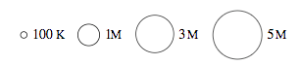
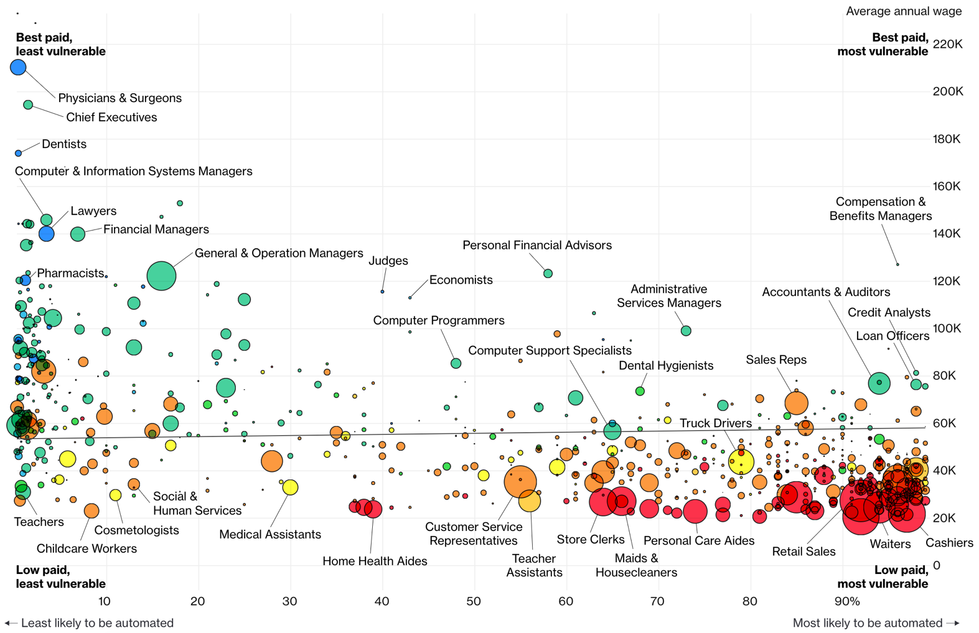
Jobs likely to be displaced by automation (esp. Neural Networks)
Bloomberg 7/2017

Slide 4
Lecture Agenda
Introduction
What is a Convolutional Neural Network (CNN)?
Tensorflow Playground CNN Demo
History of CNN advances
Application of CNNs in Image Analysis
Object Classification (Tensorflow for Poets, flower demo)
Object Detection (Tensorbox, locating mosquito breeding grounds)
Training data headaches
Using video to capture training data more easily
Cautionary notes
Intro
CNN Details
Applications
Training
Caution
Wrap Up
Notes:
Mention deep learning class in the spring

Slide 5
Intro
Edward Preble, Data Scientist at RTI International
github.com/epreble
IAA Class of 2017
Background:
Degrees in physics, materials science
Worked in semiconductor industry for 15 years
Prior to the IAA:
Little stats
No formal computer science (no python/R experience)
No exposure to deep learning
Notes:
Everyone in the room is either at or well above my level with regard to expertise needed for neural networks when I was in your seat. So, have no fear!
So, if I’m not a professor level expert on this, why am I here at the IAA lecturing on it? Transfer Learning to the rescue!

Slide 6
Projects at RTI over last 2.5 years
Data Visualization
NASA – visualize International Space Station research output BERT, Dashboard
Police body-worn camera meta-data visualization SQL, Dashboard
Federal contract data visualization SQL, Dashboard
Modeling Related
Seizure detection using ECG sensor Logistic, Basic Neural Networks
Financial risk simulation Monte Carlo Simulations
Custom object detection in drone videos Convolutional Neural Networks
Determine land use in Rwanda via satellite imagery Logistic
Determine physiological impact of lighting conditions Logistic
Drone route optimization for medical test kit delivery Optimization
Pre-symptomatic illness detection Kolmogorov-Smirnov Tests, XGBoost
Detect traumatic brain injury in ECG sensor data Logistic
Employee Retention Modeling Logistic
Software Development
Aerosol penetration of protective clothing Real time image analysis
Business Related
Confidential Client – AI Research Reports
Confidential Client – Locate novel data sources for client needs Reports
Tech
IAA Exposure
no/no
yes/no
yes/no
yes/yes
yes
no
yes
yes
yes
yes/no
yes
yes
no
yes
yes
Notes:
I did 3 projects for data vis, 9 for modeling, 1 for software dev, and 2 business related. 15 total projects.
You might say that’s a lot of projects, but consider how many teams you’ve been on and how many projects you’ve already done here in just a few months. That pace totally prepared me for RTI.
As far at the actual tech work:
For the data vis work, the SQL prep here at the IAA was great for what I needed to accomplish, and I would argue this is not a program to teach how to write javascript code for dashboards, so that isn’t unexpected.
Business related work, these projects were just like practicums, but no actual coding. We just had to brainstorm things for commercial clients who didn’t understand data science very well and give them succinct reports.
For MOST of the modeling and software dev work, I was able to use the Logistic, Monte Carlo, and Optimization, and even basic neural network work directly from my notes as starting points for the work at RTI. I was perfectly prepared for that. However, the more advance convolutional neural network stuff, I had to pick up on the job.
It is my understanding that you will have coursework on this in the spring, so that is a new add to the program, which is great.
So, even though I’m not an expert, I can pass on what I learned on the job + your coursework, and you’ll hopefully be a few steps ahead of where I was if you actually run into this stuff.

Slide 7
Lecture Agenda
Introduction
What is a Convolutional Neural Network (CNN)?
Tensorflow Playground CNN Demo
History of CNN advances
Application of CNNs in Image Analysis
Object Classification (Tensorflow for Poets, flower demo)
Object Detection (Tensorbox, locating mosquito breeding grounds)
Training data headaches
Using video to capture training data more easily
Cautionary Notes
Intro
CNN Details
Applications
Training
Caution
Wrap Up

Slide 8
What is a CNN?
Network
Interconnected things, sometimes in complex ways
Neural Network
“Neural” because it’s modelled (simplistically) on the human brain
Convolutional Neural Network
Combine 2+ functions into 1
Intro
CNN Details
Applications
Training
Caution
Wrap Up
Notes:
Neural networks, just like the human brain, there are parts that specialize in different things, like motor skills or vision, a deep neural network also has specializations in the network as well.

Slide 9
CNN Diagram for Image Analysis
All Image Pixels
Edges/Curves
Eyes/Nose
Dog
Input Data
Input Layers
Functions activate for simple features
Functions activate for complex features
Classification based on activations
Inception v3
(Google CNN Architecture)
Don’t stress about how complex this model looks. Transfer Learning will come to the rescue!
Intro
CNN Details
Applications
Training
Caution
Wrap Up

Slide 10
How are CNN’s going to automate jobs?
CNN’s are enabling a big leap for sensory data processing (auditory, visual, IoT sensors)
Image Recognition Accuracy
Intro
CNN Details
Applications
Training
Caution
Wrap Up

Slide 11
Neural network perfect storm has arrived
Viable NN Products Need:
Availability of Training Data
Complex Models (deep networks)
Hardware (GPUs)
ImageNet Competition Winning Model
Intro
CNN Details
Applications
Training
Caution
Wrap Up
Notes:
Data wise, to train a CNN to identify a complex object, one needs ~10,000 diverse examples of the object
A computer can’t tell a dog and a cat apart with just a few variables
If you have a ton of data, and a very complex model, you need fast computing. Introduction of GPU usage for these calculations was key.

Slide 12
Lecture Agenda
Introduction
What is a Convolutional Neural Network (CNN)?
Tensorflow Playground CNN Demo
History of CNN advances
Application of CNNs in Image Analysis
Object Classification (Tensorflow for Poets, flower demo)
Object Detection (Tensorbox, locating mosquito breeding grounds)
Training data headaches
Using video to capture training data more easily
Cautionary Notes
Intro
CNN Details
Applications
Training
Caution
Wrap Up

Slide 13
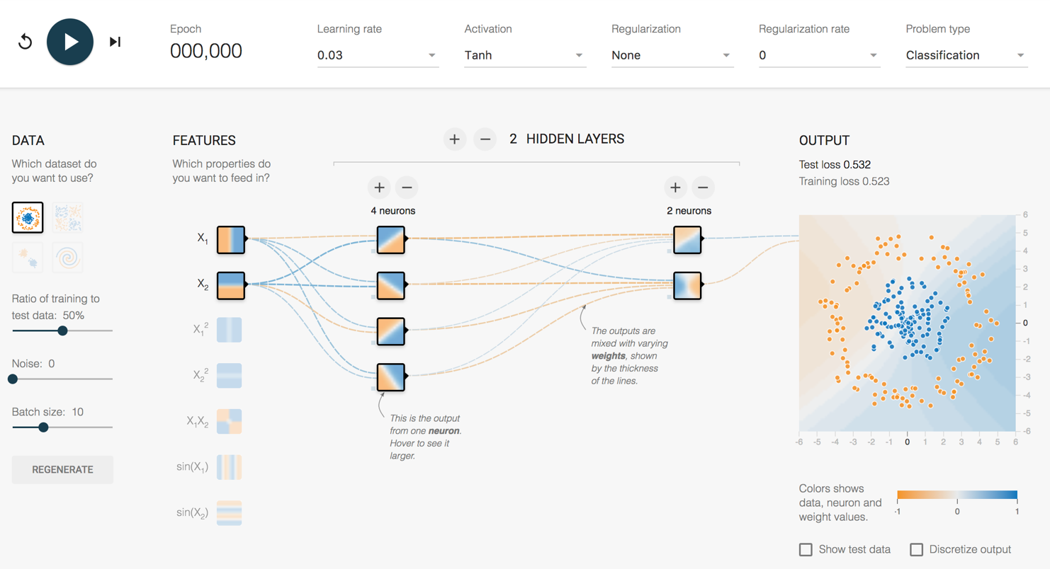
How does it work?
http://playground.tensorflow.org/
Intro
CNN Details
Applications
Training
Caution
Wrap Up

Slide 14
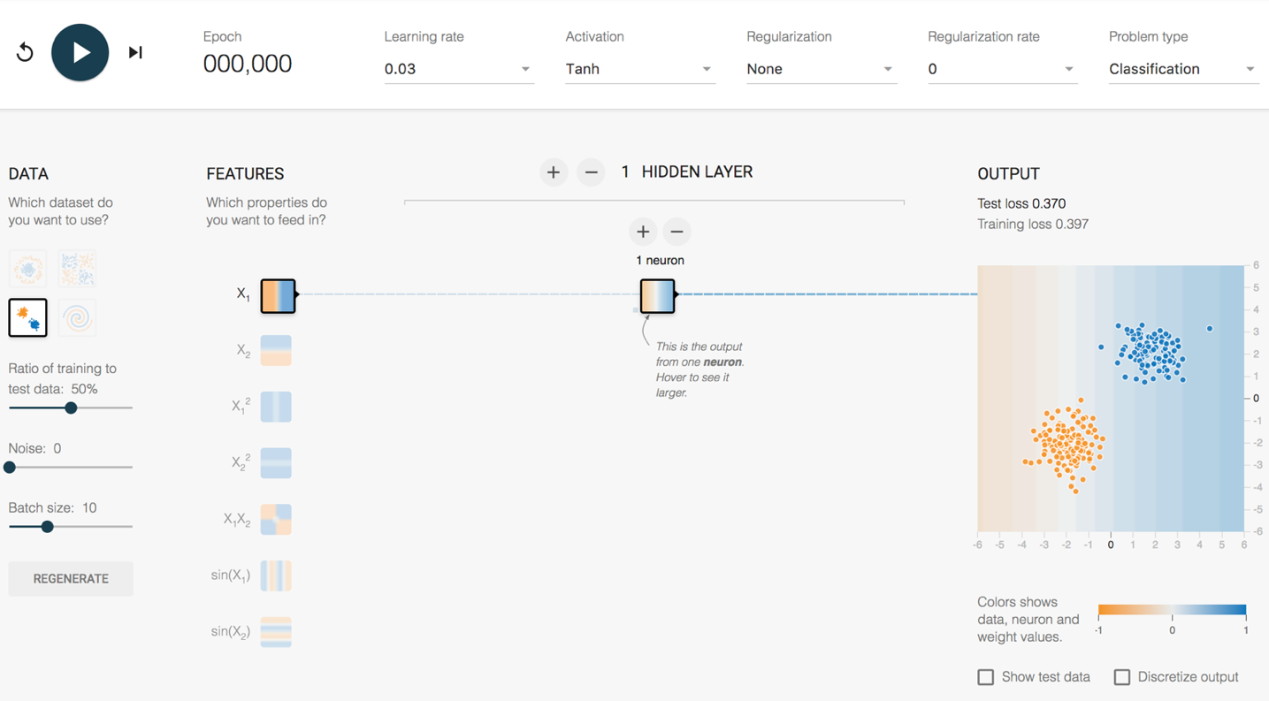
Playground Demo 1
2 Clumps 1 Feature 1 Hidden Layer
1 Neuron
Intro
CNN Details
Applications
Training
Caution
Wrap Up
Notes:
Explain tanh function (similar to logit 0-1, except -1-1)
Dividing line, left is orange, right is blue. Probability of being orange/blue is higher as you go farther from the divide.
Look at random initial weights
Single click advance the model on the vertical feature only
Watch weights increase
Division gets clearer
Test loss gets lower and lower
Reset – show learning rate effect
Activation Function – Tanh, ReLU
Single click advance the model on the horizontal feature only
Single click advance the model on the vertical + horizontal
Show next 3 features that they don’t work
This is a fundamental problem of SHALLOW NETWORKS. Bad feature = Bad results.
Fundamental strength of CNNs is that they automatically choose the features that work!
Do all 5 together
Weights that increase are said to be ACTIVATED

Slide 15
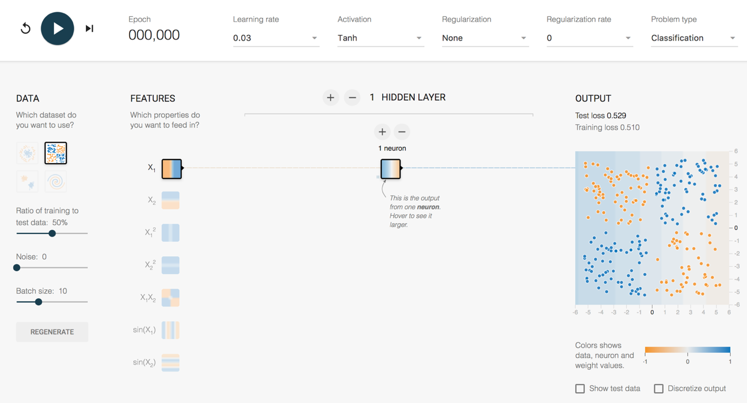
Playground Demo 2
4 Clumps 1 Feature 1 Hidden Layer
1 Neuron
Intro
CNN Details
Applications
Training
Caution
Wrap Up
Notes:
Lets take the same model, and try some transfer learning. Let’s “TRANSFER” this model to new data.
1 feature, 1 layer, 1 neuron – terrible
2 feature, 1 layer, 1 neuron – now get an angle, better
Lets add a second layer
2 feature, 2 layer, 1/1 neuron – Makes no sense to have single neuron into single neuron, can reverse info, but can’t adjust it
Add second neuron to layer 1
2 feature, 2 layer, 2/1 neuron – Sometimes single line, like above. Sometimes more of a “corner”, sometimes makes a valley (best)
Hover over neurons and weights for each neuron to show how it adds up
So, with a small network, what is the best way to make this work?
Use the feature that fits the data better – Choose the X1X2 feature
With small networks of the past, feature engineering was where everyone worked to make this stuff happen. Good features = Good model. Bad features = no luck.
But, what is the magic feature to tell a cat apart from a dog?

Slide 16
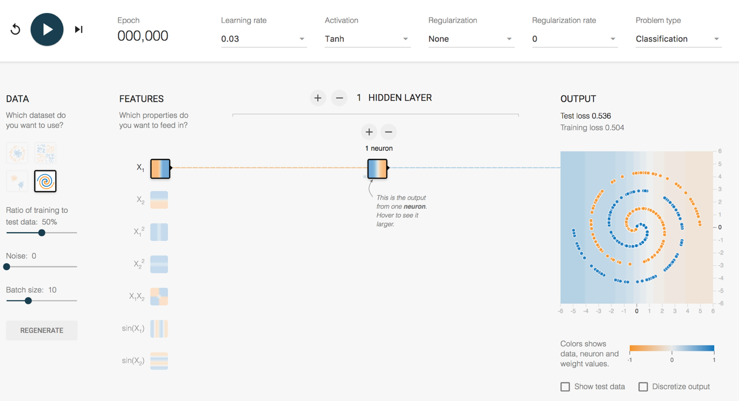
Playground Demo 3
Spiral 1 Feature 1 Hidden Layer
1 Neuron
Intro
CNN Details
Applications
Training
Caution
Wrap Up
Notes:
More complex Shape – Spiral
1 feature, 1 layer, 1 neuron – terrible
All features, - starts making dots
All features , 1 layer, 2 neurons
All features – Keep trying until a semblance of a spiral
All features , 2 layers, 2 neurons, spirals lots of other stuff
All features , 5 layers, top layers are washed out. No new combinations being generated.
All features , 5 layers, 5/4/3/2/1, might get it
6 layers, 7/6/5/4/3/2, starts working pretty well pretty quickly – weird looking, but works
Early layers are dots/blobs
Later layers are complex – spirals start to appear
Look how many crazy interconnections!! ~160 weights – that’s a lot of potential combinations!

Slide 17
How does a CNN “Learn”?
Backpropagation
Initial network settings are random
Test prediction using training data
Adjust network by a certain amount (Learning Rate) to reduce the error
Start at the end of the network and work backwards
?
Dog
Dog
Dog
?
Cat
Cat
Cat
?
?
Intro
CNN Details
Applications
Training
Caution
Wrap Up

Slide 18
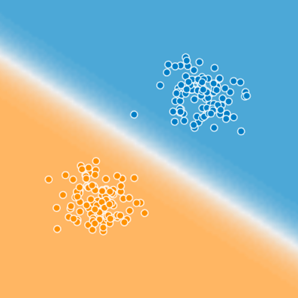

Is That All I Need to Know?
What we really
care about
Dot Separation
Awesomeness
Cat
Videos
Intro
CNN Details
Applications
Training
Caution
Wrap Up
Notes:
So, is that it? Now I know how to separate color blind appropriate color dots? I need to know more to tackle the internet’s most important activity, which is working on cat videos. I need code that can tell me that this is a cat, typing on a laptop, in the kitchen.
Can tensorflow playground do that? No, obviously it can’t. We need much more sophisticated models.

Slide 19
How complex are these things?
All Image Pixels
Edges/Curves
Eyes/Nose
Dog
Input Data
Input Layers
Detection Filter
Simple Features
Detection Filter
Complex Features
Classification
Inception v3
(Google CNN Architecture)
Number of Parameters = 23,200,000
Number of Layers = 48
Intro
CNN Details
Applications
Training
Caution
Wrap Up
Notes:
Back to the structure of the CNN, and how these layers start really working for complex images.
For an image, the input layers, instead of being data points like the playground example, they will be the actual pixel values for the image. The last model I used at RTI had 704x704 pixel input images, with 3 colors (RGB), which translates into ~1.5M input neurons.
So, you feed this image into the network, certain neurons and features will “activate”, which will then output at the end, is it blue or orange? Is it a cat or a dog?
On Inception v3, the number of layers is 48, the number of parameters is ~23M, the number of multiply/add calculations per sweep is ~5B.
This is DEEP LEARNING. There is a ton going on under the hood.

Slide 20
Lecture Agenda
Introduction
What is a Convolutional Neural Network (CNN)?
Tensorflow Playground CNN Demo
History of CNN advances
Application of CNNs in Image Analysis
Object Classification (Tensorflow for Poets, flower demo)
Object Detection (Tensorbox, locating mosquito breeding grounds)
Training data headaches
Using video to capture training data more easily
Cautionary Notes
Intro
CNN Details
Applications
Training
Caution
Wrap Up

Slide 21
History of CNN Advances (Early)
1943 - Model an algorithm on human neurons
1970s/80s
Computers gaining broad acceptance, but computational speed still too slow
1990 - Yann Lecun (Bell Labs, now at Facebook)
Number recognition using LeNet (first CNN application)
Big Data? 60,000 hand written post office zip code samples
2006 - Geoff Hinton (Univ. of Toronto, now at Google)
Stacked several shallow networks together → First “Deep Network” (4-8 layers)
2009 - Geoff Hinton
Trained voice recognition network in <3 weeks
Matched state of the art tech that took decades to build
Intro
CNN Details
Applications
Training
Caution
Wrap Up
Notes:
https://www.youtube.com/watch?v=n6XSDA3kfEw
http://slazebni.cs.illinois.edu/spring17/lec01_cnn_architectures.pdf

Slide 22
History of CNN Advances (Recent)
2011 -
For image recognition, typical networks were shallow (~4 layers)
2012 – Geoff Hinton (again)
AlexNet, 8 layers
Major image analysis breakthrough
Huge leap for CNNs. Python based. GPU trained.
2014
22 layers – Inception v1 (GoogLeNet)
2015
48 Layers – Inception v3
152 Layers – ResNet
2017
Tensorflow libraries open-sourced by Google
Intro
CNN Details
Applications
Training
Caution
Wrap Up

Slide 23
How long to train 23,200,000 parameters?

Slide 24
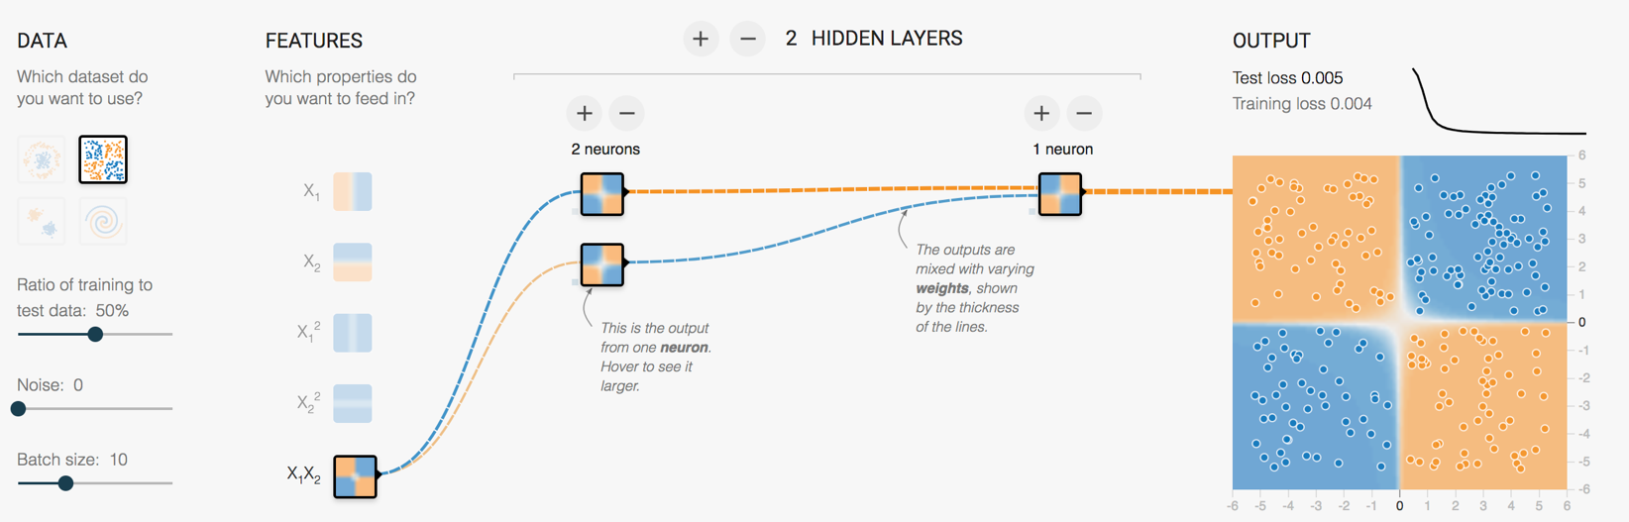
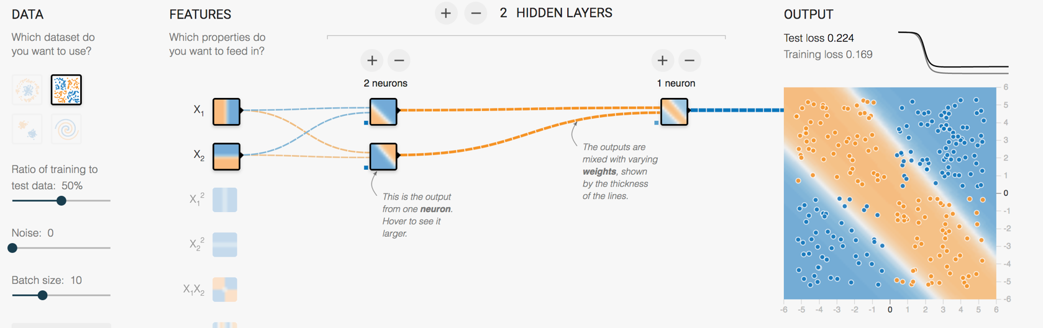
Another key advance
Retraining the last layer is all that is needed for basic human recognizable objects
ImageNet trained weights for Inception v3 are downloadable
Intro
CNN Details
Applications
Training
Caution
Wrap Up
Notes:
Remember beginning of lecture, to make the 4 blob data work, we could battle with linear features and a few layer/neuron combos
Or, just needed to use the right feature and it works instantly
Google (and others) have figured out those features and pre-trained a number of model architectures

Slide 25
Where are we today
Computational platform → Tensorflow
Model architecture → Inception_v3 structure
ImageNet pre-trained weights
Python scripts to handle the retraining
Intro
CNN Details
Applications
Training
Caution
Wrap Up

Slide 26
Lecture Agenda
Introduction
What is a Convolutional Neural Network (CNN)?
Tensorflow Playground CNN Demo
History of CNN advances
Application of CNNs in Image Analysis
Object Classification (Tensorflow for Poets, flower demo)
Object Detection (Tensorbox, locating mosquito breeding grounds)
Training data headaches
Using video to capture training data more easily
Cautionary Notes
Intro
CNN Details
Applications
Training
Caution
Wrap Up

Slide 27
Applications of CNNs in Image Analysis
Classification
& Localization
Instance
Segmentation
Classification
Object Detection
Intro
CNN Details
Applications
Training
Caution
Wrap Up

Slide 28
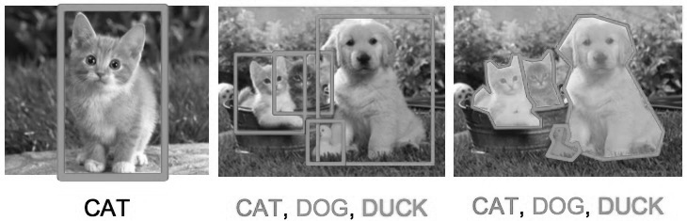
Applications of CNNs in Image Analysis
Classification
& Localization
Instance
Segmentation
Classification
Object Detection
Intro
CNN Details
Applications
Training
Caution
Wrap Up

Slide 29
Object Classification
Original Demo from Google: https://codelabs.developers.google.com/codelabs/tensorflow-for-poets
My Jupyter notebooks available on GitHub https://github.com/epreble/neural_network_presentations
Intro
CNN Details
Applications
Training
Caution
Wrap Up
Notes:
There is a google demo, called tensorflow for poets, that we can check out.
This demo will create an image classifier that can classify 5 types of flowers.
I’m going to go through the setup quickly, but I have created a jupyter notebook that you can download later to mimic this. My notebook has more detail, especially on installation, which might make it easier to get this thing working for you.
1. Setup of tensorflow
2. Download code to retrain the model
3. Download training pictures
4. My notebook deviates from the demo a little here, because there are bugs that I want to point out, and because I want to actually hold out some of the images to test with later on.
5. I copy 15 images out of the training folder so the model will never see them.

Slide 30
Lecture Agenda
Introduction
What is a Convolutional Neural Network (CNN)?
Tensorflow Playground CNN Demo
History of CNN advances
Application of CNNs in Image Analysis
Object Classification (Tensorflow for Poets, flower demo)
Object Detection (Tensorbox, locating mosquito breeding grounds)
Training data headaches
Using video to capture training data more easily
Cautionary Notes
Intro
CNN Details
Applications
Training
Caution
Wrap Up

Slide 31
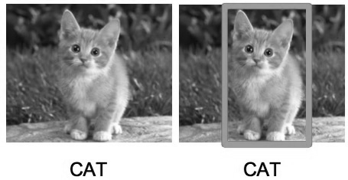
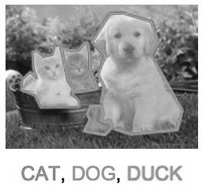
Applications of CNNs in Image Analysis
Classification
& Localization
Instance
Segmentation
Classification
Object Detection
Intro
CNN Details
Applications
Training
Caution
Wrap Up

Slide 32
Existing Applications of Object Detection
Autonomous driving – All driving context objects
Manufacturing – Anomaly detection for quality control
Face recognition – Customer or friend identification
People counting – Store visitor or crowd counting
Online image censoring – Nudity, violence, contraband detection
Security – Automated detection of weapons, intruders
Intro
CNN Details
Applications
Training
Caution
Wrap Up

Slide 33
Object Detection – RTI Use Case
Mosquito breeding site identification in Guatemala
Current Solution
Walking teams
Desired Solution
Target map assists walking team
Intro
CNN Details
Applications
Training
Caution
Wrap Up

Slide 34
Lecture Agenda
Introduction
What is a Convolutional Neural Network (CNN)?
Tensorflow Playground CNN Demo
History of CNN advances
Application of CNNs in Image Analysis
Object Classification (Tensorflow for Poets, flower demo)
Object Detection (Tensorbox, locating mosquito breeding grounds)
Training data headaches
Using video to capture training data more easily
Cautionary Notes
Intro
CNN Details
Applications
Training
Caution
Wrap Up

Slide 35
Organizing Image Training Data
Can be VERY time consuming
Data science 80/20 rule
Object Detection Requires:
Images
Object class bounding boxes
Different input file types
Image1, Cat, x/y coordinates
Intro
CNN Details
Applications
Training
Caution
Wrap Up

Slide 36
Real world images can be very busy
Intro
CNN Details
Applications
Training
Caution
Wrap Up

Slide 37
A better way
Use Video & Object Tracking to generate lots of training images Demo Object_Tracker_for_Video.py
Intro
CNN Details
Applications
Training
Caution
Wrap Up
Notes:
Object tracker for Drone Use Case
Just perfectly labeled 3720 images for a unique object case!
In Pycharm, switch to Charlie Chaplin
Works for Chaplin
Doesn’t work for couple behind him

Slide 38
Lecture Agenda
Introduction
What is a Convolutional Neural Network (CNN)?
Tensorflow Playground CNN Demo
History of CNN advances
Application of CNNs in Image Analysis
Object Classification (Tensorflow for Poets, flower demo)
Object Detection (Tensorbox, locating mosquito breeding grounds)
Training data headaches
Using video to capture training data more easily
Cautionary Notes
Intro
CNN Details
Applications
Training
Caution
Wrap Up
Notes:
Good place for questions!

Slide 39
Gartner Hype Cycle for 2018
Intro
CNN Details
Applications
Training
Caution
Wrap Up

Slide 40
3 Major Areas for Caution
Artificial Intelligence Hype
Data Bias
Model Bias
Intro
CNN Details
Applications
Training
Caution
Wrap Up

Slide 41
Spot the Bad Idea
Use existing HR data
Make a model to predict employee retention rates
Make a model to predict if Ed Preble will quit
Use AI to
Find all the patents that will lead to products that are competitive with ours
Analyze twitter data for social trends related to e-cigarettes
“Just get the data” and
Literally any statement…
Intro
CNN Details
Applications
Training
Caution
Wrap Up
Notes:
AI is NOT yet a general purpose tool
Going to repeat that: AI is NOT yet a general purpose tool
AI can be used for highly specific, well defined, and usually data rich use cases

Slide 42
Intro
CNN Details
Applications
Training
Caution
Wrap Up

Slide 43
Data Bias
Where would you add armor?
Help the plane steer
Help the plane land
Protect the people on the plane
1
1
3
2
World War 2 Post-Mission Bomber Damage Locations

Slide 44
Model Bias
What if a flower classification model is better at roses than tulips?
What if a law enforcement facial recognition model is better at Caucasian faces compared with African American faces?
How might that impact real people?
Don’t ignore the ethics of how a model might be applied. Make those discussions happen.
Intro
CNN Details
Applications
Training
Caution
Wrap Up

Slide 45
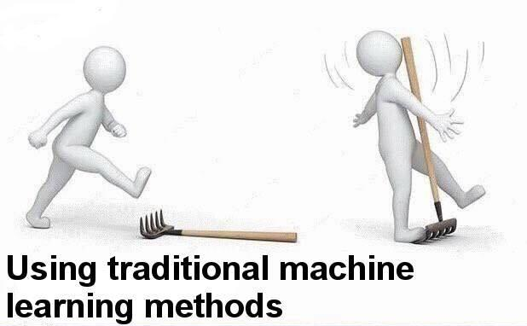
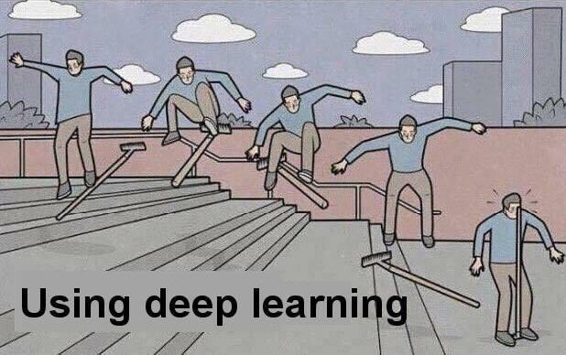
Sometimes Simple is Better
Hmmm… Logistic Didn’t Work?!?
Deep Learning is awesome,
maybe that will work?
Intro
CNN Details
Applications
Training
Caution
Wrap Up

Slide 46
Resources to Learn More
Entry Level Videos:
Josh Gordon (Google) Machine Learning Tutorials https://www.youtube.com/watch?v=cKxRvEZd3Mw
Siraj Raval - Various Artificial Intelligence Videos https://www.youtube.com/channel/UCWN3xxRkmTPmbKwht9FuE5A
More Advanced
Adrian Rosebrock (Lots of Python and OpenCV Materials) https://www.pyimagesearch.com/
Geoffrey Hinton’s Coursera Class https://www.coursera.org/learn/neural-networks
Intro
CNN Details
Applications
Training
Caution
Wrap Up

Slide 47
Thanks!
Break Time!
Optional demo next
Demo goals:
Train an Inception v3 model to recognize 3 students
Use video to get 200+ training images quickly
Train the model and test it!
Intro
CNN Details
Applications
Training
Caution
Wrap Up

